Slide 1


IT Data Security Lecture Series
V Semester CSF
Dr. Narendra Kumar Dewangan
Assistant Professor, Senior Scale
Systems, School of Computer Sciences
UPES Dehradun
Data Security Threat Techniques

Slide 2

Contents
Brute Force Attack
Cryptanalysis
Side Channel Attack
Birthday Attack
Chosen Ciphertext attack
Hash Collison
Key Reinstallation
Wean Random Number Generator
SSL TLS Vulnerbilities

Slide 3
Cryptographic Based Threat Techniques
Brute Force Attack
Cryptanalysis
Side-Channel Attacks
Birthday Attack
Replay Attack

Slide 4
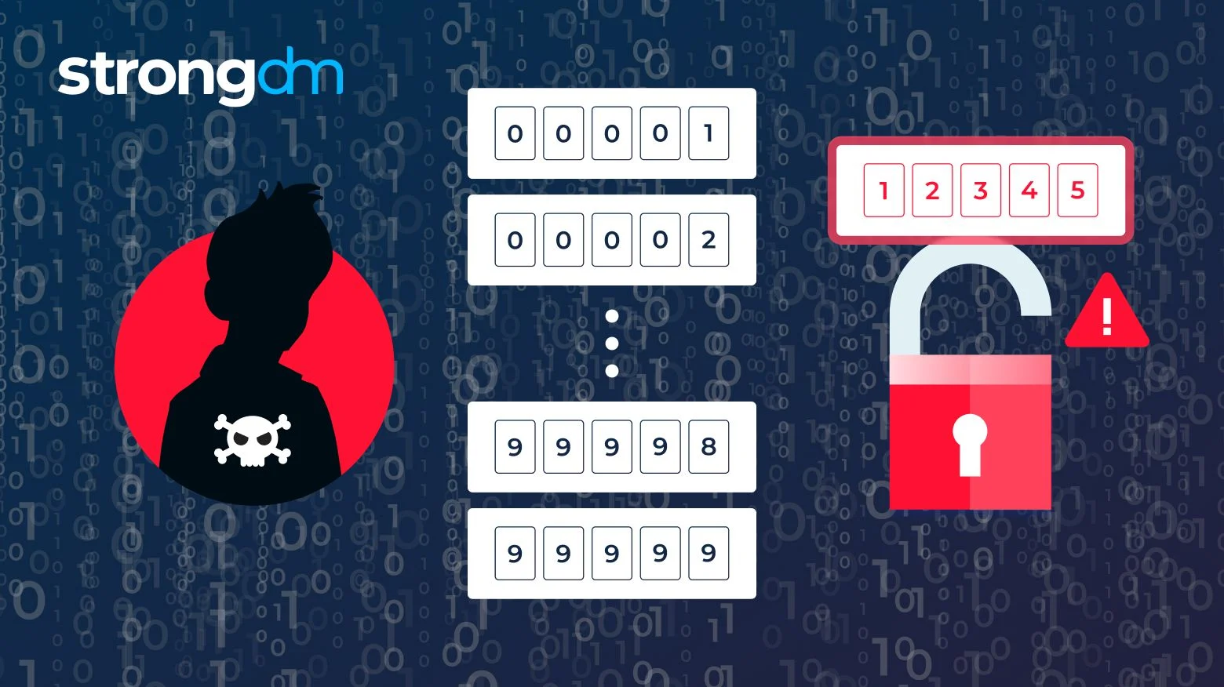
Brute Force Attack

Slide 5
Introduction
A Brute Force Attack is a method used by attackers to gain unauthorized access to a system, account, or encrypted data by systematically trying all possible combinations of passwords, encryption keys, or credentials until the correct one is found. The attacker exhausts all potential options without relying on any specific knowledge of the target credentials. It is a time-consuming process but can be very effective if the target uses weak or simple passwords.

Slide 6
Types of Brute Force Attacks:
Simple Brute Force Attack:
Involves attempting every possible combination of characters until the right password or key is found.
Dictionary Attack:
Instead of trying all possible combinations, attackers use a precompiled list of likely passwords (called a dictionary) to guess the correct one.
Hybrid Brute Force Attack:
A combination of dictionary and brute force methods. It uses a dictionary to guess passwords and then tries variations (e.g., adding numbers or symbols).
Credential Stuffing:
This method involves using a list of previously breached username/password combinations to try and gain access to other accounts, exploiting the habit of password reuse.

Slide 7
Types of Brute Force Attacks:
Simple Brute Force Attack:
Involves attempting every possible combination of characters until the right password or key is found.
Dictionary Attack:
Instead of trying all possible combinations, attackers use a precompiled list of likely passwords (called a dictionary) to guess the correct one.
Hybrid Brute Force Attack:
A combination of dictionary and brute force methods. It uses a dictionary to guess passwords and then tries variations (e.g., adding numbers or symbols).
Credential Stuffing:
This method involves using a list of previously breached username/password combinations to try and gain access to other accounts, exploiting the habit of password reuse.

Slide 8
Tools
Hydra: Hydra is one of the most widely used tools for performing brute force attacks against network services and protocols. It supports a large number of protocols such as HTTP, SSH, FTP, SMB, and many more.
John the Ripper: John the Ripper is a powerful password-cracking tool, best known for performing offline brute force and dictionary attacks on password hashes.
Hashcat: Hashcat is one of the fastest password-cracking tools due to its ability to leverage GPU acceleration. It can perform both brute force and dictionary attacks on password hashes.

Slide 9
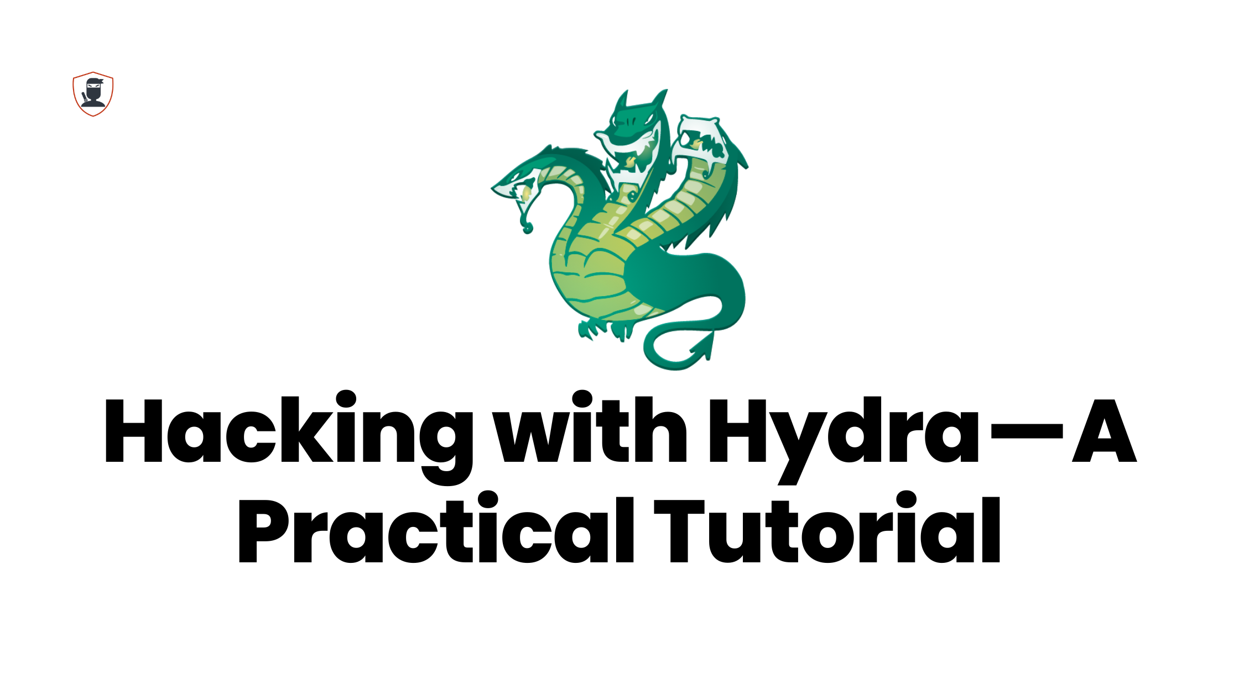
Hydra
Key Features:
Supports many protocols (HTTP, SSH, FTP, SMTP, etc.).
Modular design allows easy extension.
Fast and highly configurable.
Use Case: Network service brute-forcing (e.g., SSH login, web forms, FTP servers).

Slide 10
Tutorial
Installation: apt install hydra
hydra –h
How to Perform a Single Username/Password Attack with Hydra
hydra -l <username> -p <password> <server> <service>
Example
hydra -l molly -p butterfly 10.10.137.76 ssh

Slide 11
How to Perform a Password Spraying Attack with Hydra
hydra -L users.txt -p butterfly 10.10.137.76 ssh
How to Perform a Dictionary Attack with Hydra
hydra -L users.txt -P /usr/share/wordlists/rockyou.txt 1010.137.76 ssh

Slide 12
John the Ripper
John the Ripper is a fast password cracker, currently available for many flavors of Unix (11 are officially supported, not counting different architectures), DOS, Win32, BeOS, and OpenVMS. Its primary purpose is to detect weak Unix passwords. (openfirewall.com)

Slide 13
John the Ripper
In order to run John the Ripper, we went to a site and downloaded the documents for windows that gave instructions on how to run it. (this included the password file, and other documents about john)
To run John, we did the following:
Start >Accessories>Windows Explorer>My computer>John>
In the command prompt, we typed:
– cd c:\John\john171w\john1701\run
-dir
-john386pass
This invoked John

Slide 14
Stages
Though there are different types of password cracking utilities, most of these go through the same types of stages when trying to crack passwords:
-tries common passwords, such as "password" or the name of the account in question
-runs through all the words in the dictionary and lists of common passwords.
-runs through all the words in foreign dictionaries and special "crack" dictionaries.
-tries all combinations of letters out to a certain size, such as 5 letters.
-tries all combinations of letters, upper/lower case, numbers, and punctuation out to a certain size, such as 3 characters

Slide 15
Hashcat
Install- apt install hashcat
hashcat –h
To crack a password using Hashcat, here is the general syntax.
$ hashcat -m value -a value hashfile wordlist
For the attack mode, we will be using the dictionary mode (0) using the flag -a. Here is the full command:
$ hashcat -m 0 -a 0 md5.txt rockyou.txt

Slide 16
Hashcat
hashcat -m 100 -a 0 sha1.txt rockyou.txt

Slide 17
Cryptanalysis

Slide 18
Differential and Linear Cryptanalysis Origins
Differential cryptanalysis originally defined on DES
Eli Biham and Adi Shamir, Differential Cryptanalysis of the Data Encryption Standard, Springer Verlag, 1993.
Linear cryptanalysis first defined on Feal by Matsui and Yamagishi, 1992.
Matsui later published a linear attack on DES.

Slide 19
Linear Cryptanalysis
Attack Overview
Obtain linear approximation(s) of the cipher relating P,K,C
⊕_{i∈X,} p_{i} ⊕ _{j∈Y} c_{j} = ⊕_{g∈Z} k_{g}
which occur with probability pr = ½ + e for max bias -½ ≤ e_{i} ≤ ½ .
Encrypt random P’s to obtain C’s and compute k_{g}’s.
Known plaintext attack
Guess remaining key bits via exhaustive search.

Slide 20
Differential Cryptanalysis
Notation
P = plaintext
C = ciphertext
(P1,P2) = plaintext pair
(C1,C2) = ciphertext pair
ΔP = P1 ⊕ P2
ΔC = C1 ⊕ C2
Characteristic: Ω = (λ_{i1},λ_{o1},λ_{i2},λ_{o2},….λ_{ir},λ_{or})
λ_{ij}= ⊕ of inputs to round j
λ_{oj}= ⊕ of outputs from round j
If pr_{j}= probability λ_{oj} occurs given λ_{ij}
then probability of Ω = Π pr_{j} ‘s (upper bound)
Notes:
Differential = (ΔP,ΔC)
Prob. If characteristic is an estimate – assumes independent random variables when S-Boxes, key expansion and other cipher components are not independent (i.e. when design won’t have two = S-Boxes).
Expect 1/probability of char. pairs to get a pair that matches the char and thus can guess key bits. (so use small multiple of this due to prob being estimate and wanting confirmation don’t have wrong pair – want correct result for more than one pair to be sure.)
Differential may hold for some pairs under wrong key guess.
-------------------------------------------------------------------------
Iterative characteristic: one that can be concatenated with itself.

Slide 21
Replay Attack
Eve can listen in and impersonate Alice later
Alice Bob
Eve
“I am Alice”, x, E(x, k)
“I am Alice”, x, E(x)
Notes:
Note that Eve does not know what k is, but if Eve can sniff the network and see what E(x, k) is, she can simply repeat it.

Slide 22
Preventing Replay Attacks
Bob can issue a challenge phrase to Alice
Alice Bob
“I am Alice”
x
E(x, k)
Notes:
NOTE FOR NEXT TIME: This isn’t really the right way to do it, since it’s still vulnerable to spoofing and other such things. Do better next time.
Why is this different? Interception is much less likely here, and since each “x” is only used once, attacks can be detected.
Disregard spoofing, real-time attacks.

Slide 23

Thank you

